Slide 1
Positive Behavioral support Strategies
Emphasizing “Learning” and “Relearning” not “consequence” and “Punishment”
Notes:
Insert Joanne's notes
Welcome
To Rhode Island as well as a special shout out to Georgia and Mississippi
Part 2 of our series Behavior Success series
Which will explore…Positive Behavior Support Strategies
Emphasizing “Learning” and “Relearning”
Not
“Consequence” and Punishment”
Explores how using Positive Intervention Strategies within the classroom and school environment
Decreases problem behavior and increases positive social behavior in students with or without disabilities.
This webinar introduces a variety of preventative strategies that include direct intervention methods, communication techniques, self-regulation and self-management when supporting students .
We will focus on Positive Behavior Supports as a strategy for creating culture change within our schools for the betterment of all students,,, not just students with disabilities.
PBS emerged 12 years ago as an alternative approach to traditional approaches
Which focused on
Correcting problem behavior to “fix students”
To “Reframing “ the problem behavior
“Understanding “ its function
And
“change” the “Environment "in which problem behavior occurs…) not the student!

Slide 2
Take a moment
Notes:
Take a moment
Settings situations where you need to call upon your coping skills to manage your environment
What do you do to escape or avoid, if that is your need?
or
Pick one of the following reflections
What do you to get attention or recognition for an accomplishment or success if that is your need?
What natural or designed supports help you manage your daily life.
Think of the environments you are in home, school , work.
Ways we escape-restroom, breakroom, close office door, quiet time.

Slide 3
Review of our understanding of Problem behavior, function and intervention
Notes:
On the subject of Expecting students to behave…
Yes we live in an educational world of high expectations
yes we need to challenge our students to perform and that includes behaving appropriately.
However, guess what? If the student is displaying behaviors that are maladaptive, inappropriate, dangerous, harmful, or just interfering with his or others' learning, then the expectation of behavior did not work.
Expecting acceptable or appropriate behavior is no different than expecting a student to do calculus. I
f we haven't taught it, he hasn't learned it, or has a skill deficit learning in math, he's not going to be able to do it.
Joanne notes assume kids know innately how to…
Our following slides will serve as our review of our understanding of problem behavior, function of behavior and proven successful intervention.

Slide 4
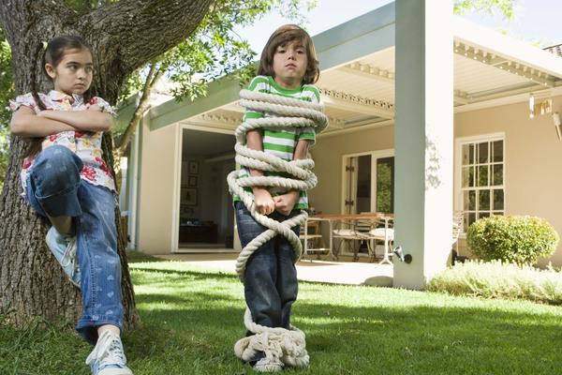
Problem Behavior
Definition of problem behavior is behavior that is socially defined as a source of concern or is undesirable by social norms.
Notes:
Problem behaviors are behaviors that show consistent patterns
Joanne Example: The student who …

Slide 5
Function
Function is the reason behavior occurs. All behavior serves a purpose…
Allows student to get something desirable.
Escape or avoid something undesirable.
Communicate some other message or need.
Notes:
Joanne Example:

Slide 6
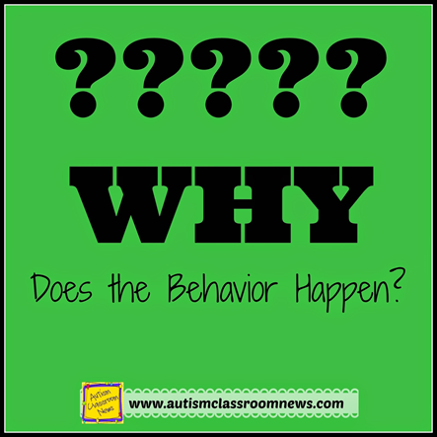
intervention
Functional Behavioral Assessment (FBA)
A systematic process used to determine the function a student’s behavior is serving and involves examining the relationship between a student’s behavior and the environment in which it occurs.
Notes:
FBA
Information derived from the FBA
Is a a key component in determining potential environment changes, supports and reinforces. (examples:
designated safe place for establishment of self-regulation,
coping mechanisms,
acknowledgment by adult to “allow” students “space” and “time” to regroup;
assigned seating close to teacher to avoid confrontation with peers, receive positive praise (gestures, verbal) , proximity to keep student focused on task,
flexibility with teacher expectation,
Reward system; self-management skills: instruction in teaching crisis management strategies.
IEP Team decides creates BSP!

Slide 7
What is PBIS?
Notes:
Joanne review
Key Principles of Practice
Focus is on changing the environment, not changing the person
Uses a process (FBA) in designing supports
Learning and Relearning not consequence and punishment
It is proactive not reactive
Interventions are designed to be preventative
Designed to promote safety , respect, responsibility through social Emotional Learning Principles
Eliminate the problem behavior by teaching replacement behaviors
Increase a persons skills set

Slide 8
What is pbis : video
What is pbis : video
Notes:
https://youtu.be/eqQ7icUA-sY
Stop at
3:17
We are ready to watch a video created by Montgomery County Public Schools
The largest school system in Maryland with over 155,000 students.
Let’s watch some sharing of learning using PBIS from The Weller Road School.
You can be watching for strategies that you think would be helpful with your students.

Slide 9
Function Junction
Provides school wide consistency with teaching/managing behavior.
Reduces problem behavior and increases valuable instructional time in classroom.
Behavior Monitoring charts offers structure for students to monitor their own behavior.
Produces data for teachers to analyze behavior trends.
Affords consistent behavior management approach across school and home settings.
Notes:
We noticed the following key points about PBS form our video…refer to above key points
Joanne review/add

Slide 10
Identify student challenges
Behavioral Challenges for Students with ASD in the classroom:
Trouble understanding language
Difficulty experiencing sensory input
Inconsistent routines
Struggle with knowing another person’s opinion or feelings
Frustration with participating in activities with no clear ending
Transitions
Stress with unstructured time
Notes:
(Finding meaning and quality in students lives)
We choose to focus on ASD
Seems to present challenges for schools and families
Characteristics of students with ASD
Understanding language or certain aspects of language - Such as sarcasm , expression and body language
Sensory- such as vacuum cleaner sounding very loud, smell be extra strong, feel of something could be extra itchy
Routine- need for structure with routines, very clear schedules
Knowing another person feeling –visual cues of facial recognition
Participating in activities- open ended writing activity
Transitions- switching form one activity or person to another.
Stress with unstructured- They need the first ..and then…activities
Joanne connect to PBIS

Slide 11
Proven Strategies for managing behavioral challenges
Strategies for creating a successful environment for students with ASD:
Let student know what will happen next.
Set expectations- be consistent with follow through.
Acknowledge student for complying with request.
Give choices to empower student.
Allow students to bring an object from one activity to another it makes them feel more comfortable in unfamiliar surroundings.
Identifying quieter places to escape possible sensory overload.
Use visual schedules to let student know about the events of the day.
Distract or redirect problematic behavior instead of saying “Stop” or “No”.
Task assignments or activities need to be specific with start and end times.
Give hands-on visual activities.
Notes:
Share Poem Source: http://www.autismclassroomnews.com/
PBIS to support students with ASD
1. Let student know what will happen next
(example: when you finish with your puzzle, go to your seat.)
use red clock visual timers
picture cues telling them what is expected
Set expectations , be consistent and follow through
(example: adult says “read” to the student , if student completes task in 5 minutes, then adult needs to follow through when stated
3. Acknowledge student for complying with requests
( example If student is using a load voice and adult says “Whisper in class”, praise student with specific words ”Nice job whispering in class, or Thank you for whispering.”)
Give Choices
(example: “do you want peanut butter and jelly on your bagel?)
“Do you wan to wear the green or red shirt?”
5. Transition Activities allows the student to bring an object from one location to another (or staff form one to another)
(example: stress ball, or toy car)

Slide 12
Increasing socials skills development to promote prosocial behavior
Types of Social Skills:
Survival Skills-
Listening, following direction, ignoring distractions, rewarding self
Interpersonal Skills
Sharing, asking for permission, joining in an activity, starting a conversation, waiting your turn
Problem Solving Skills
Asking for help, deciding what to do, accepting consequence, apologizing
Conflict Resolution Skills
Getting along with peers, dealing with losing, accusations/teasing, being left out
Notes:
These 4 types of social skills are brought to us by
Stop and Think program
Good social skills are essential for life long learning and adulthood
Joanne review
Connect positive environment through PBIS
Most students learn
Don’t assume ?
All levels
Desired skill level
educators and parents

Slide 13
Activities to promote Social SKILLS development
Communication is an essential component for good social skill development …
Notes:
Let’s face it there are days when we all want to hide from communication…
under a book, in our offices with the door closed or in a broom closet.!
IMAGINE feeling like that every day as some of our students do…
The fear of communicating with others known and not known.
We want to share some activities we’ve found effective:
Communication:
How to introduce yourself to others
Practice Use your Head
H=Happy tone of voice
A=alternate conversation
E=eye contact
D=distance
Role play bad first then follow up with good or acceptable introductions.
Practice
Video modeling film, review, comment, film again, review, praise
Conversation Starters- hand out topics spilt into groups practice talking about topic with others.
What did you notice?
Focus on :
Social Skills
Team building
Facial Expression Recognition
Teaches desired skill not punishing.

Slide 14
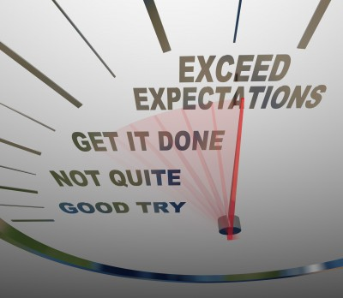
Positive supports and strategies yield positive behavior
Notes:
Scotty’s story
Young man with Autism in middle school
Challenged with communication
In school reviewed
USE YOUR HEAD
Role modeled practiced
Video modeling
Going on to do 1:1 Work with Scott and mom in their home
Excited injured self running to leave school
Mom calls to update on condition.
What did you do with Scott today in school?
Use your head
H=happy tone of voice
E=eye or ear contact
A= alternate conversation
D= Distance
Mom says
I rushed from work directly to the hospital
I walk in to see my son
Who was afraid of Doctors, unknown people and anything relating to medical care
Standing up straight
Putting out his hand to shake hands with the doctor
Looking him in the eye and in a nice tone of voice saying
“Hi, nice Mr. Doctor man, I’ll do anything you say to make me better.”
Scotty exceeded all our expectations!
Our biggest hope is to have students bringing what they are learning in the classroom out into their communities and be part of their everyday lives.

Slide 15
Practice
Creating strength based environments through PBIS
Notes:
(Social Emotional Learning)

Slide 16
www.cea.fedcap.org

